Slide 1
Natural Language Processing
Parsing

Slide 2
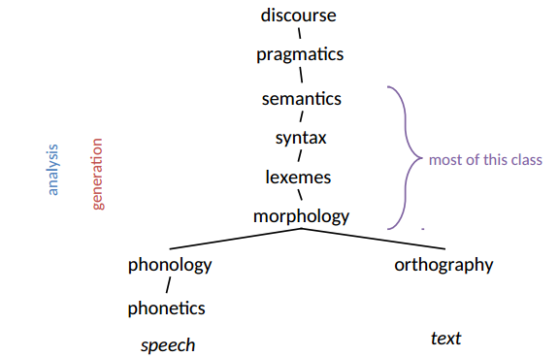
Levels of Representation

Slide 3
Overview of Last Lecture
What is Syntax?
Constituency and English Phrases
Context-free Grammars

Slide 4
Parsing
The process of finding a derivation (i. e. sequence of productions) leading from the START symbol to a TERMINAL symbol
Shows how a particular sentence could be generated by the rules of the grammar
If sentence is structurally ambiguous, more than one possible derivation is produced
Can solve both the recognition and analysis problems
Is this sentence derived from this grammar?
Give the derivation(s) that can derive this sentence.
Parsing algorithms give a strategy for finding a derivation by making choices among the derivation rules and deciding when the derivation is complete or not.

Slide 5
Top-down Parser
Hypothesis-driven
At each stage, parser hypothesizes a structure, and tests whether data (next word in sentence) fits the hypothesis
Looks at goal first (S) and then sees which rules can be applied
Typically progresses from top-to-bottom, left-to-right
Non-deterministic (can be rewritten in more than one way)
When rules derive lexical elements (words), check with the input to see if the right sentence is being derived
An algorithm may include a backtracking mechanism
When it is determined that the wrong rule has been used, it backs up and tries another rule

Slide 6
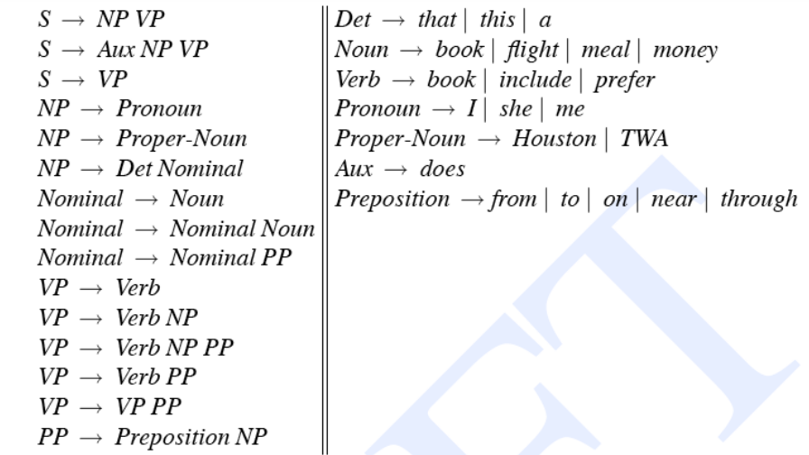
Example Grammar
The flight grammar from the text:

Slide 7
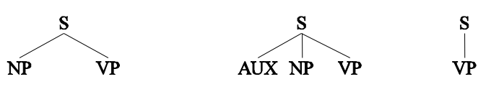
Example Derivation
Derivation for “Book that flight”
The Start symbol
S
Can derive 3 rules as follows:

Slide 8

Example Derivation
Derivation for “Book that flight”
The Start symbol
S
Can derive 3 rules as follows:
Each non-terminal can derive additional rules

Slide 9
Example Derivation
Derivation for “Book that flight”
The Start symbol
S
Can derive 3 rules as follows:
Each non-terminal can derive additional rules
Only the last two trees can derive the word “book” as first in the input

Slide 10
Bottom-up Parser
Data-driven
Looks at words in input string first, checks / assigns their category(ies), and tries to combine them into acceptable structures in the grammar
Involves scanning the derivation so far for sub-strings which match the right-hand-side of grammar / production rules and using the rule that would show their derivation from the nonterminal symbol of that rule

Slide 11
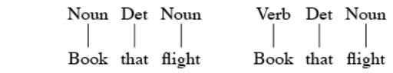
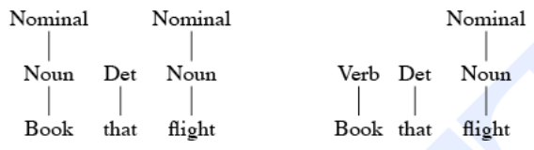
Bottom-up Derivation
Starts with input text
Book the flight
derive the text from rules, in this case, two possible lexical rules
Each of those can be derived from nonterminals

Slide 12
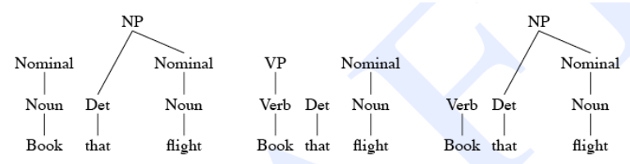
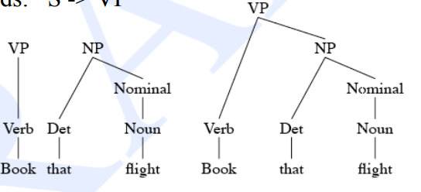
Bottom-up Derivation
Only the rightmost tree can continue the derivation here:
And only one succeeds: S -> VP

Slide 13
Bottom-up Parsing
Algorithm called shift/reduce parsing
Scans the input from left to right and keeps a “stack” of the partial parse tree so far
The shift operation looks at the next input and shifts it onto the stack
The reduce operation looks at N symbols on the stack and if they match the RHS of a grammar rule, reduces the stack by replacing those symbols with the nonterminal
Also must either incorporate back-tracking or must keep multiple possible parses

Slide 14
Parsing Issues
Top-down
Only searches for trees that can be answers (i.e. S’s)
But also suggests trees that are not consistent with any of the words
Bottom-up
Only forms trees consistent with the words
But suggest trees that make no sense globally
Note that in the previous example, there was local ambiguity between “book” being a verb or a noun that was resolved at the end of the parse
But examples with structural ambiguity will not be resolved, resulting in more than one possible derivation

Slide 15
Working with Parsing
NLTK parsing demos
Top-down parsing using a recursive descent algorithm
Top down parsing with back-tracking
Must not have left-recursion in the grammar rules
nltk.app.rdparser()
Bottom-up parsing using a shift-reduce algorithm
Instead of back-tracking or multiple parses, this NLTK implementation requires outside intervention to apply the correct rule when there is a choice
nltk.app.srparser()

Slide 16
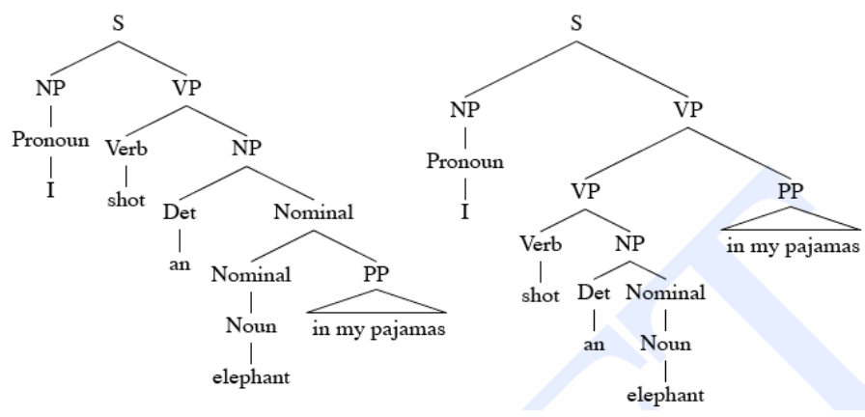
Structural Ambiguity
I shot an elephant in my pajamas

Slide 17
Treebank
Before you can parse you need a grammar.
So where do grammars come from?
Grammar Engineering
Hand-crafted decades-long efforts by humans to write grammars (typically in some particular grammar formalism of interest to the linguists developing the grammar).
TreeBanks
Semi-automatically generated sets of parse trees for the sentences in some corpus. Typically in a generic lowest common denominator formalism (of no particular interest to any modern linguist, but representing phrases of text in actual use).

Slide 18
Starting off, building a treebank seems a lot slower and less useful than building a grammar
But a treebank gives us many things
Reusability of the labor
Many parsers, POS taggers, etc. •
Valuable resource for linguistics
Broad coverage
Frequencies and distributional information
A way to evaluate systems on the same text

Slide 19
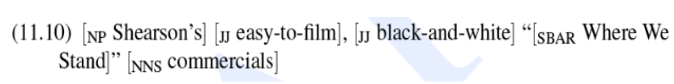

Getting Grammar from a treebank
Given an annotated sentence,
We can make a grammar rule:
And we’ll make rules for sub-trees as well

Slide 20
Treebank Grammars
Reading off the grammar…
The grammar is the set of rules (local subtrees) that occur in the annotated corpus
They tend to avoid recursion (and elegance and parsimony) – i.e. they tend to the flat and redundant
Penn TreeBank (III) has about 17500 grammar rules under this definition.
But the main use of the Treebank is to provide the probabilities to inform the statistical parsers, and the grammar does not actually have to be generated.
The grammar hovers behind the Treebank; it is in the minds of the human annotators (and in the annotation manual!)

Slide 21
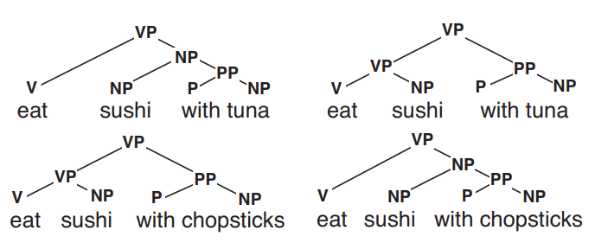
Grammars are ambiguous
A grammar might generate multiple trees for a sentence:
What’s the most likely parse τ for sentence S ?
We need a model of P(τ | S)

Slide 22
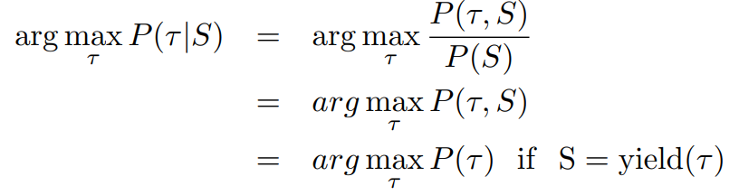
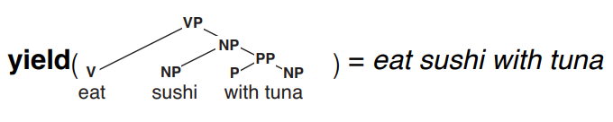
Computing P(τ | S)
Using Bayes’ Rule:
The yield of a tree is the string of terminal symbols that can be read off the leaf nodes

Slide 23
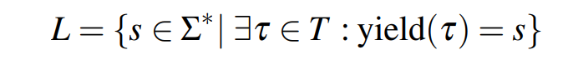
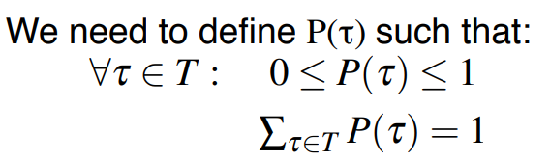
Computing P(τ)
T is the (infinite) set of all trees in the language:
We need to define P(τ) such that:

Slide 24
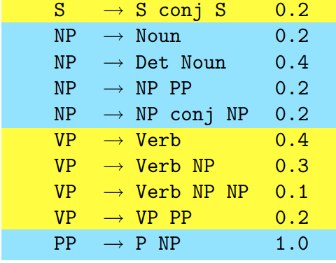
Probabilistic Context-Free Grammars
For every nonterminal X, define a probability distribution P(X → α | X) over all rules with the same LHS symbol X:

Slide 25
Computing P(τ) with a PCFG
The probability of a tree τ is the product of the probabilities of all its rules:
John eats pie with cream
S -> NP VP | 0.8
S -> S conj S | 0.2
NP -> Noun | 0.2
NP -> Det Noun | 0.4
NP -> NP PP | 0.2
NP-> NP conj NP | 0.2
VP-> Verb | 0.4
VP -> Verb NP | 0.3
VP ->Verb NP NP | 0.1
VP -> VP PP | 0.2
PP -> P NP | 1.0

Slide 26
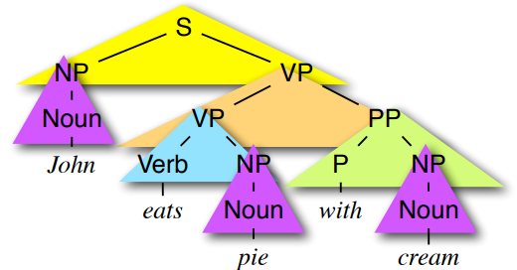
S -> NP VP | 0.8
S -> S conj S | 0.2
NP -> Noun | 0.2
NP -> Det Noun | 0.4
NP -> NP PP | 0.2
NP-> NP conj NP | 0.2
VP-> Verb | 0.4
VP -> Verb NP | 0.3
VP ->Verb NP NP | 0.1
VP -> VP PP | 0.2
PP -> P NP | 1.0

Slide 27
Context-Free Grammars in Chomsky Normal Form
Vocabulary of terminal symbols, Σ
Set of non-terminal symbols (a.k.a. variables), N
Special start symbol S ∈ N
Production rules of the form X → α
where
X ∈ N
α ∈ N,N U Σ

Slide 28
Convert CFGs to CNF
For each rule
X → A B C
Rewrite as
X → A X2
X2 → B C
Introducing a new non-terminal

Slide 29
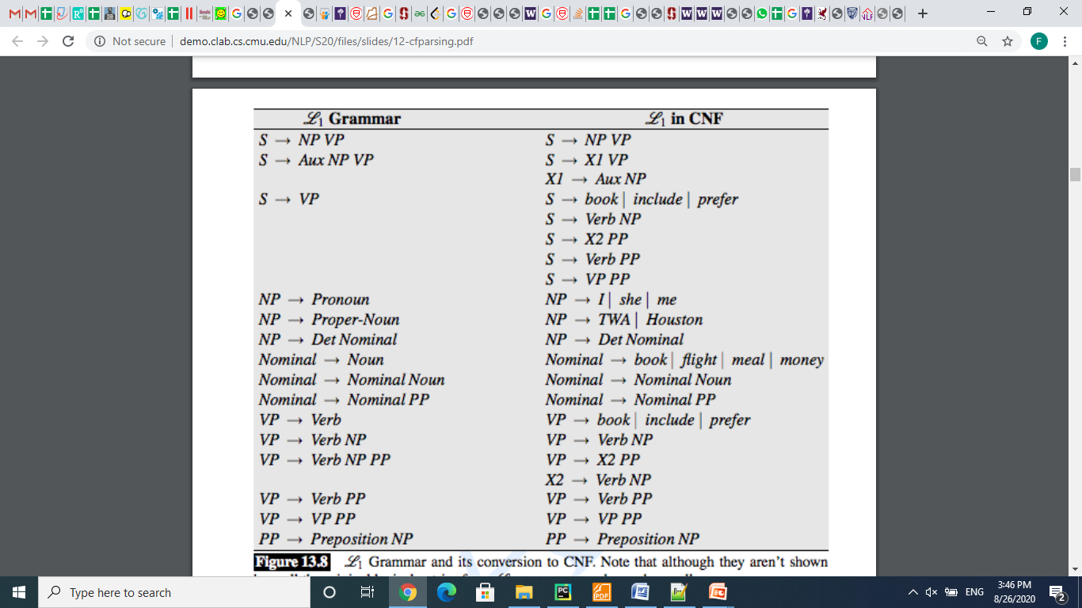
CFG to CNF

Slide 30
CFG to CNF
VP → VBD NP PP PP

Slide 31
Chart Parsers
CKY (Cocke-Kasami-Younger) algorithm is an example
Bottom-up parser
Requires grammar to be in Chomsky Normal Form, with only two symbols on the right-hand-side of each production
All CFG grammars have a Chomsky Normal Form
Grammar rule with 3 RHS symbols: NP -> Det NP PP
Transformed to equivalent grammar with only 2 RHS symbols: NP -> Det NPtemp Nptemp -> NP PP
Fills in a data structure called a chart or a parse triangle •
Binarization is key in reducing exponential process
Where binarization means only reducing rules with 2 RHS symbols
Other parsers, such as Earley’s algorithm, use similar chart ideas to work on two subtrees at a time
Key idea in parser development from 1970 - 1990

Slide 32
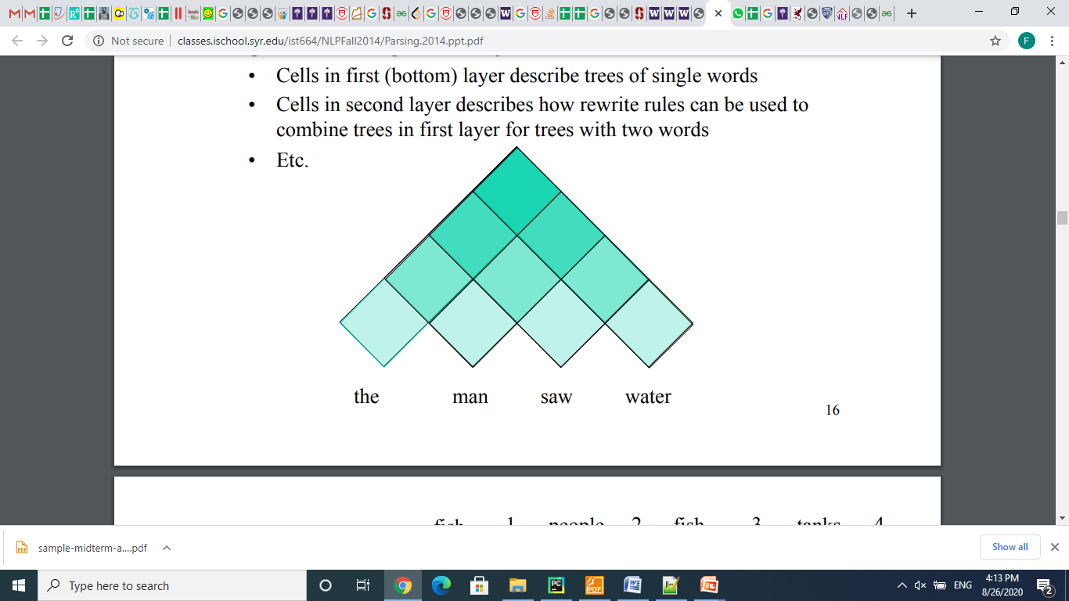
CKY Parsing
For input of length n, fills a parse table triangle of size (n+1, n+1) , where each element has the non-terminal production representing the span of text from position i to j.
Cells in first (bottom) layer describe trees of single words
Cells in second layer describes how rewrite rules can be used to combine trees in first layer for trees with two words

Slide 33
Constituency Parsing
fish people fish tanks
PCFG
Rule Prob θ_{i}
S → NP VP θ₀
NP → NP NP θ₁
…
N → fish θ₄₂
N → people θ₄₃
V → fish θ₄₄
…
S
VP
NP
NP
N
N
V
N
Notes:
Want to work out all possible structures licensed by grammar.
In PCFG want to find the highest probability one.
Without doing any repeated work.
Probs for all rules with the same parent sum to 1.
Prob of a parse is product of probs of all the rules
Probs estimated by reading counts off of the treebank - it’s a generative model

Slide 34
Cocke-Kasami-Younger (CKY) Constituency Parsing
fish people fish tanks

Slide 35
Viterbi (Max) Scores
NP→NN NNS 0.13
i_{NP} = (0.13)(0.0023)(0.0014)
= 1.87 × 10⁻⁷
NP→NNP NNS 0.056
i_{NP} = (0.056)(0.001)(0.0014)
= 7.84 × 10⁻⁸
S 1.87 × 10⁻⁷
VP
VP 0.06
NP 0.14
V 0.6
N 0.2
NP 0.35
V 0.1
N 0.5
people fish

Slide 36
Viterbi (Max) Scores
S → NP VP 0.9
S → VP 0.1
VP → V NP 0.5
VP → V 0.1
VP → V @VP_V 0.3
VP → V PP 0.1
@VP_V → NP PP 1.0
NP → NP NP 0.1
NP → NP PP 0.2
NP → N 0.7
PP → P NP 1.0
VP 0.06
NP 0.14
V 0.6
N 0.2
NP 0.35
V 0.1
N 0.5
people fish
Notes:
NP -> NP NP = 0.35 * 0.14 * 0.1 = 0.0049
VP -> V NP = 0.1 * 0.14 * 0.5 = 0.007
S -> VP = 0.007 * 0.1 = 0.0007
S -> NP VP = 0.35 * 0.06 * 0.9 = 0.0189

Slide 37
Extended CKY parsing
Unaries can be incorporated into the algorithm
Messy, but doesn’t increase algorithmic complexity
Empties can be incorporated
Use fenceposts
Doesn’t increase complexity; essentially like unaries
Binarization is vital
Without binarization, you don’t get parsing cubic in the length of the sentence and in the number of nonterminals in the grammar
Binarization may be an explicit transformation or implicit in how the parser works (Earley-style dotted rules), but it’s always there.

Slide 38
The CKY algorithm (1960/1965) … extended to unaries
function CKY(words, grammar) returns [most_probable_parse,prob]
score = new double[#(words)+1][#(words)+1][#(nonterms)]
back = new Pair[#(words)+1][#(words)+1][#nonterms]]
for i=0; i<#(words); i++
for A in nonterms
if A -> words[i] in grammar
score[i][i+1][A] = P(A -> words[i])
//handle unaries
boolean added = true
while added
added = false
for A, B in nonterms
if score[i][i+1][B] > 0 && A->B in grammar
prob = P(A->B)*score[i][i+1][B]
if prob > score[i][i+1][A]
score[i][i+1][A] = prob
back[i][i+1][A] = B
added = true

Slide 39
The CKY algorithm (1960/1965) … extended to unaries
for span = 2 to #(words)
for begin = 0 to #(words)- span
end = begin + span
for split = begin+1 to end-1
for A,B,C in nonterms
prob=score[begin][split][B]*score[split][end][C]*P(A->BC)
if prob > score[begin][end][A]
score[begin]end][A] = prob
back[begin][end][A] = new Triple(split,B,C)
//handle unaries
boolean added = true
while added
added = false
for A, B in nonterms
prob = P(A->B)*score[begin][end][B];
if prob > score[begin][end][A]
score[begin][end][A] = prob
back[begin][end][A] = B
added = true
return buildTree(score, back)

Slide 40
Quiz Question!
PP → IN 0.002
NP → NNS NNS 0.01
NP → NNS NP 0.005
NP → NNS PP 0.01
VP → VB PP 0.045
VP → VB NP 0.015
?? ??
?? ??
PP 0.2
IN 0.0014
NNS 0.0001
NNS 0.0023
VB 0.001
What constituents (with what probability can you make?
runs down

Slide 41
Quiz Question!
PP → IN 0.002
NP → NNS NNS 0.01
NP → NNS NP 0.005
NP → NNS PP 0.01
VP → VB PP 0.045
VP → VB NP 0.015
NP->NNS PP ??
NP->NNS NNS??
VP->VB PP ??
PP 0.2
IN 0.0014
NNS 0.0001
NNS 0.0023
VB 0.001
What constituents (with what probability can you make?
runs down

Slide 42
The grammar: Binary, no epsilons,
S → NP VP 0.9
S → VP 0.1
VP → V NP 0.5
VP → V 0.1
VP → V @VP_V 0.3
VP → V PP 0.1
@VP_V → NP PP 1.0
NP → NP NP 0.1
NP → NP PP 0.2
NP → N 0.7
PP → P NP 1.0
N → people 0.5
N → fish 0.2
N → tanks 0.2
N → rods 0.1
V → people 0.1
V → fish 0.6
V → tanks 0.3
P → with 1.0
Notes:
Start discussing unary removal downwards: remove S → VP

Slide 43
fish
1
people
2
fish
3
tanks
4
0
score[0][1]
score[0][2]
score[0][3]
score[0][4]
1
score[1][2]
score[1][3]
score[1][4]
2
score[2][3]
score[2][4]
3
score[3][4]
4

Slide 44
fish
1
people
2
fish
3
tanks
4
S → NP VP 0.9
S → VP 0.1
VP → V NP 0.5
VP → V 0.1
VP → V @VP_V 0.3
VP → V PP 0.1
@VP_V → NP PP 1.0
NP → NP NP 0.1
NP → NP PP 0.2
NP → N 0.7
PP → P NP 1.0
N → people 0.5
N → fish 0.2
N → tanks 0.2
N → rods 0.1
V → people 0.1
V → fish 0.6
V → tanks 0.3
P → with 1.0
0
1
2
3
for i=0; i<#(words); i++
for A in nonterms
if A -> words[i] in grammar
score[i][i+1][A] = P(A -> words[i]);
4

Slide 45
fish
1
people
2
fish
3
tanks
4
S → NP VP 0.9
S → VP 0.1
VP → V NP 0.5
VP → V 0.1
VP → V @VP_V 0.3
VP → V PP 0.1
@VP_V → NP PP 1.0
NP → NP NP 0.1
NP → NP PP 0.2
NP → N 0.7
PP → P NP 1.0
N → people 0.5
N → fish 0.2
N → tanks 0.2
N → rods 0.1
V → people 0.1
V → fish 0.6
V → tanks 0.3
P → with 1.0
0
N → fish 0.2
V → fish 0.6
1
N → people 0.5
V → people 0.1
2
N → fish 0.2
V → fish 0.6
// handle unaries
boolean added = true
while added
added = false
for A, B in nonterms
if score[i][i+1][B] > 0 && A->B in grammar
prob = P(A->B)*score[i][i+1][B]
if(prob > score[i][i+1][A])
score[i][i+1][A] = prob
back[i][i+1][A] = B
added = true
3
N → tanks 0.2
V → tanks 0.1
4

Slide 46
fish
1
people
2
fish
3
tanks
4
S → NP VP 0.9
S → VP 0.1
VP → V NP 0.5
VP → V 0.1
VP → V @VP_V 0.3
VP → V PP 0.1
@VP_V → NP PP 1.0
NP → NP NP 0.1
NP → NP PP 0.2
NP → N 0.7
PP → P NP 1.0
N → people 0.5
N → fish 0.2
N → tanks 0.2
N → rods 0.1
V → people 0.1
V → fish 0.6
V → tanks 0.3
P → with 1.0
0
N → fish 0.2
V → fish 0.6
NP → N 0.14
VP → V 0.06
S → VP 0.006
1
N → people 0.5
V → people 0.1
NP → N 0.35
VP → V 0.01
S → VP 0.001
2
N → fish 0.2
V → fish 0.6
NP → N 0.14
VP → V 0.06
S → VP 0.006
3
N → tanks 0.2
V → tanks 0.1
NP → N 0.14
VP → V 0.03
S → VP 0.003
prob=score[begin][split][B]*score[split][end][C]*P(A->BC)
if (prob > score[begin][end][A])
score[begin]end][A] = prob
back[begin][end][A] = new Triple(split,B,C)
4
Notes:
And then start the binaries.

Slide 47
fish
1
people
2
fish
3
tanks
4
S → NP VP 0.9
S → VP 0.1
VP → V NP 0.5
VP → V 0.1
VP → V @VP_V 0.3
VP → V PP 0.1
@VP_V → NP PP 1.0
NP → NP NP 0.1
NP → NP PP 0.2
NP → N 0.7
PP → P NP 1.0
N → people 0.5
N → fish 0.2
N → tanks 0.2
N → rods 0.1
V → people 0.1
V → fish 0.6
V → tanks 0.3
P → with 1.0
0
N → fish 0.2
V → fish 0.6
NP → N 0.14
VP → V 0.06
S → VP 0.006
NP → NP NP
0.0049
VP → V NP
0.105
S → NP VP
0.00126
1
N → people 0.5
V → people 0.1
NP → N 0.35
VP → V 0.01
S → VP 0.001
NP → NP NP
0.0049
VP → V NP
0.007
S → NP VP
0.0189
2
N → fish 0.2
V → fish 0.6
NP → N 0.14
VP → V 0.06
S → VP 0.006
NP → NP NP
0.00196
VP → V NP
0.042
S → NP VP
0.00378
//handle unaries
boolean added = true
while added
added = false
for A, B in nonterms
prob = P(A->B)*score[begin][end][B];
if prob > score[begin][end][A]
score[begin][end][A] = prob
back[begin][end][A] = B
added = true
3
N → tanks 0.2
V → tanks 0.1
NP → N 0.14
VP → V 0.03
S → VP 0.003
4
Notes:
Unaries change 0,2 and 2,4 S scores

Slide 48
fish
1
people
2
fish
3
tanks
4
S → NP VP 0.9
S → VP 0.1
VP → V NP 0.5
VP → V 0.1
VP → V @VP_V 0.3
VP → V PP 0.1
@VP_V → NP PP 1.0
NP → NP NP 0.1
NP → NP PP 0.2
NP → N 0.7
PP → P NP 1.0
N → people 0.5
N → fish 0.2
N → tanks 0.2
N → rods 0.1
V → people 0.1
V → fish 0.6
V → tanks 0.3
P → with 1.0
0
N → fish 0.2
V → fish 0.6
NP → N 0.14
VP → V 0.06
S → VP 0.006
NP → NP NP
0.0049
VP → V NP
0.105
S → VP
0.0105
1
N → people 0.5
V → people 0.1
NP → N 0.35
VP → V 0.01
S → VP 0.001
NP → NP NP
0.0049
VP → V NP
0.007
S → NP VP
0.0189
2
N → fish 0.2
V → fish 0.6
NP → N 0.14
VP → V 0.06
S → VP 0.006
NP → NP NP
0.00196
VP → V NP
0.042
S → VP
0.0042
3
N → tanks 0.2
V → tanks 0.1
NP → N 0.14
VP → V 0.03
S → VP 0.003
for split = begin+1 to end-1
for A,B,C in nonterms
prob=score[begin][split][B]*score[split][end][C]*P(A->BC)
if prob > score[begin][end][A]
score[begin]end][A] = prob
back[begin][end][A] = new Triple(split,B,C)
4

Slide 49
fish
1
people
2
fish
3
tanks
4
S → NP VP 0.9
S → VP 0.1
VP → V NP 0.5
VP → V 0.1
VP → V @VP_V 0.3
VP → V PP 0.1
@VP_V → NP PP 1.0
NP → NP NP 0.1
NP → NP PP 0.2
NP → N 0.7
PP → P NP 1.0
N → people 0.5
N → fish 0.2
N → tanks 0.2
N → rods 0.1
V → people 0.1
V → fish 0.6
V → tanks 0.3
P → with 1.0
0
N → fish 0.2
V → fish 0.6
NP → N 0.14
VP → V 0.06
S → VP 0.006
NP → NP NP
0.0049
VP → V NP
0.105
S → VP
0.0105
NP → NP NP
0.0000686
VP → V NP
0.00147
S → NP VP
0.000882
1
N → people 0.5
V → people 0.1
NP → N 0.35
VP → V 0.01
S → VP 0.001
NP → NP NP
0.0049
VP → V NP
0.007
S → NP VP
0.0189
2
N → fish 0.2
V → fish 0.6
NP → N 0.14
VP → V 0.06
S → VP 0.006
NP → NP NP
0.00196
VP → V NP
0.042
S → VP
0.0042
3
N → tanks 0.2
V → tanks 0.1
NP → N 0.14
VP → V 0.03
S → VP 0.003
for split = begin+1 to end-1
for A,B,C in nonterms
prob=score[begin][split][B]*score[split][end][C]*P(A->BC)
if prob > score[begin][end][A]
score[begin]end][A] = prob
back[begin][end][A] = new Triple(split,B,C)
4
Notes:
Results for 0,1 and 1,3
But everything done the other way is lower.
NP -> NP NP for 0,2 and 2,3 is same; A TIE !!; VP is impossible;
S is 0.0049 * 0.06 * 0.9 = 0.0002646
Then doing unaries does nothing (0.000147 S)
Then do (1,4) cell.

Slide 50
fish
1
people
2
fish
3
tanks
4
S → NP VP 0.9
S → VP 0.1
VP → V NP 0.5
VP → V 0.1
VP → V @VP_V 0.3
VP → V PP 0.1
@VP_V → NP PP 1.0
NP → NP NP 0.1
NP → NP PP 0.2
NP → N 0.7
PP → P NP 1.0
N → people 0.5
N → fish 0.2
N → tanks 0.2
N → rods 0.1
V → people 0.1
V → fish 0.6
V → tanks 0.3
P → with 1.0
0
N → fish 0.2
V → fish 0.6
NP → N 0.14
VP → V 0.06
S → VP 0.006
NP → NP NP
0.0049
VP → V NP
0.105
S → VP
0.0105
NP → NP NP
0.0000686
VP → V NP
0.00147
S → NP VP
0.000882
1
N → people 0.5
V → people 0.1
NP → N 0.35
VP → V 0.01
S → VP 0.001
NP → NP NP
0.0049
VP → V NP
0.007
S → NP VP
0.0189
NP → NP NP
0.0000686
VP → V NP
0.000098
S → NP VP
0.01323
2
N → fish 0.2
V → fish 0.6
NP → N 0.14
VP → V 0.06
S → VP 0.006
NP → NP NP
0.00196
VP → V NP
0.042
S → VP
0.0042
3
N → tanks 0.2
V → tanks 0.1
NP → N 0.14
VP → V 0.03
S → VP 0.003
for split = begin+1 to end-1
for A,B,C in nonterms
prob=score[begin][split][B]*score[split][end][C]*P(A->BC)
if prob > score[begin][end][A]
score[begin]end][A] = prob
back[begin][end][A] = new Triple(split,B,C)
4
Notes:
(1,4) S ->

Slide 51
fish
1
people
2
fish
3
tanks
4
0
N → fish 0.2
V → fish 0.6
NP → N 0.14
VP → V 0.06
S → VP 0.006
NP → NP NP
0.0049
VP → V NP
0.105
S → VP
0.0105
NP → NP NP
0.0000686
VP → V NP
0.00147
S → NP VP
0.000882
NP → NP NP
0.0000009604
VP → V NP
0.00002058
S → NP VP
0.00018522
S → NP VP 0.9
S → VP 0.1
VP → V NP 0.5
VP → V 0.1
VP → V @VP_V 0.3
VP → V PP 0.1
@VP_V → NP PP 1.0
NP → NP NP 0.1
NP → NP PP 0.2
NP → N 0.7
PP → P NP 1.0
N → people 0.5
N → fish 0.2
N → tanks 0.2
N → rods 0.1
V → people 0.1
V → fish 0.6
V → tanks 0.3
P → with 1.0
1
N → people 0.5
V → people 0.1
NP → N 0.35
VP → V 0.01
S → VP 0.001
NP → NP NP
0.0049
VP → V NP
0.007
S → NP VP
0.0189
NP → NP NP
0.0000686
VP → V NP
0.000098
S → NP VP
0.01323
2
N → fish 0.2
V → fish 0.6
NP → N 0.14
VP → V 0.06
S → VP 0.006
NP → NP NP
0.00196
VP → V NP
0.042
S → VP
0.0042
3
N → tanks 0.2
V → tanks 0.1
NP → N 0.14
VP → V 0.03
S → VP 0.003
4
Call buildTree(score, back) to get the best parse
Notes:
(0,4) S from NP(0,2) + VP(2,4) = 0.0049 * 0.042 * 0.9 =

Slide 52
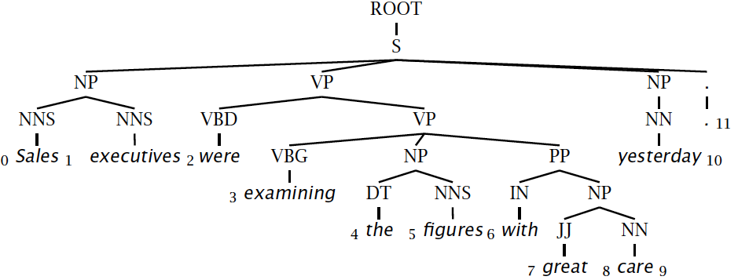
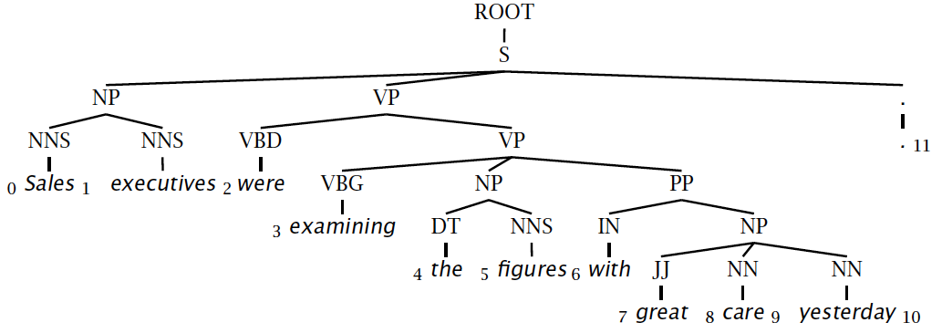
Evaluating constituency parsing
Notes:
Most sentences are not given a completely correct parse by any currently existing parser.
A constituent is a triple, which must be exact in the true parse for the constituent to be marked correct.

Slide 53
Evaluating constituency parsing
Gold standard brackets:
S-(0:11), NP-(0:2), VP-(2:9), VP-(3:9), NP-(4:6), PP-(6-9), NP-(7,9), NP-(9:10)
Candidate brackets:
S-(0:11), NP-(0:2), VP-(2:10), VP-(3:10), NP-(4:6), PP-(6-10), NP-(7,10)
Labeled Precision 3/7 = 42.9%
Labeled Recall 3/8 = 37.5%
LP/LR F1 40.0%
Tagging Accuracy 11/11 = 100.0%
Notes:
This isn’t necessarily a great measure … me and many other people think dependency accuracy would be better.

Slide 54
How good are PCFGs?
Penn WSJ parsing accuracy: about 73% LP/LR F1
Robust
Usually admit everything, but with low probability
Partial solution for grammar ambiguity
A PCFG gives some idea of the plausibility of a parse
But not so good because the independence assumptions are too strong
Give a probabilistic language model
But in the simple case it performs worse than a trigram model
The problem seems to be that PCFGs lack the lexicalization of a trigram model

